Slide 1
Statistics 367-1-4361 Models
Opher Donchin

Slide 2
2.1 What is a statistical model
Estimation, models, and generative thinking

Slide 3
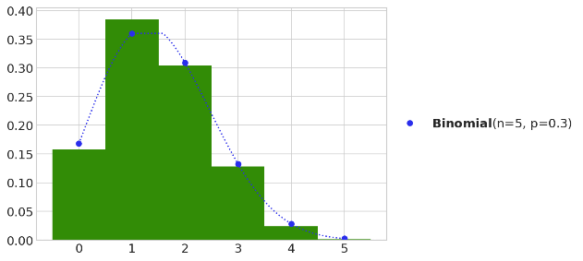
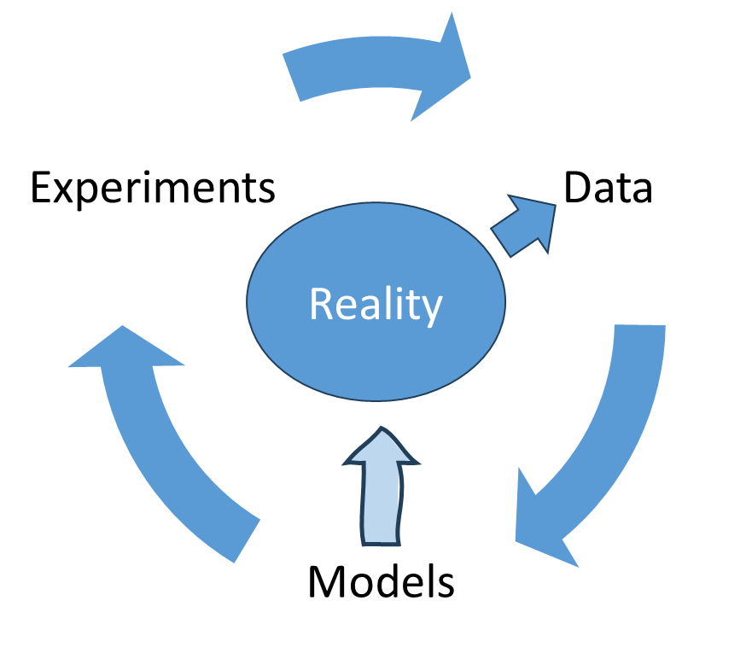
A statistical model is an idea of how data could be generated
Data is generated stochastically (probabilistically):
To describe that process, we need:
A particular distribution
Defined by specific parameters

Slide 4
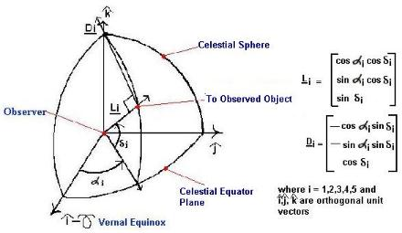
Very early, models of the world used in estimation
Early researchers realized noisy data could be used for estimation
Laplace used Bayes’ rule (1812)
Estimate parameters of planetary orbits
Explicit mathematical model and inverse probability
Observations

Slide 5
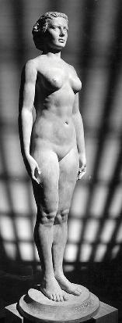
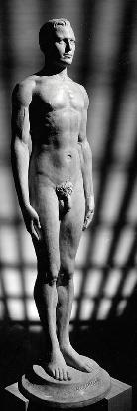
In search for objectivity, estimation overshadowed modeling
Stepping away from models
Models made sense for physical sciences
Racial “scientists” wanted to estimate abstract relations
Adolphe Quetelet (1835) estimated height of “average man”
Francis Galton (1869) : correlation of head size and intelligence
Karl Pearson (1890) : optimal estimates given noisy data
Frequentist statistics focuses on the behavior of “estimators”
An interest in “average man”
Something that can’t be modelled
A summary
Not a real physical process

Slide 6
Estimators as a goal of data analysis
Data
Estimator
Experiments
Parameter

Slide 7
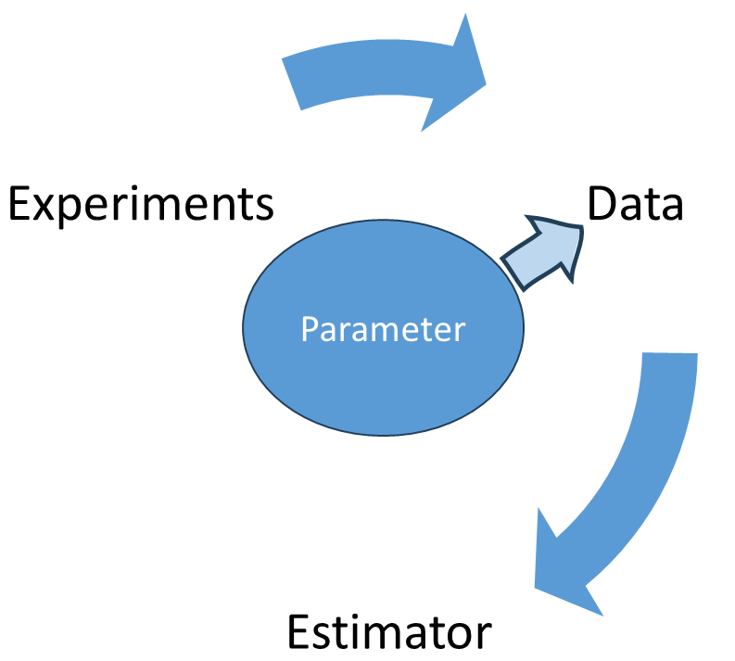
Models re-emerge in likelihood methods
Stepping back towards models
Ronald Fisher
The Design of Experiments (1935)
Objectivity with political impact
Made likelihood central
Likelihood links parameter values to observed data
Models return as useful tools
Likelihood

Slide 8
Models are not just tools for estimation
Harold Jeffreys
Theory of probability (1939)
Models express current scientific understanding
Data updates beliefs within the model
Working on internal structure of the earth from seismic waves
Parameters always have uncertainty
They are random variables

Slide 9
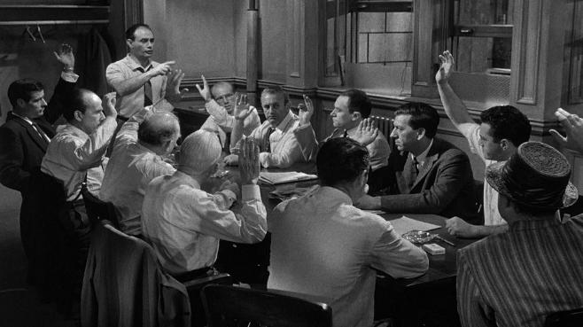
A model is an idea of how data is generated
It has:
Probability distributions
Parameters
12 Angry Men:
Woman on train
Saw the boy stab his father
Man downstairs
Heard boy say “I’ll kill you”
Saw boy run down stairs
Weapon was switchblade
Like one owned by boy
Weak alibi

Slide 10
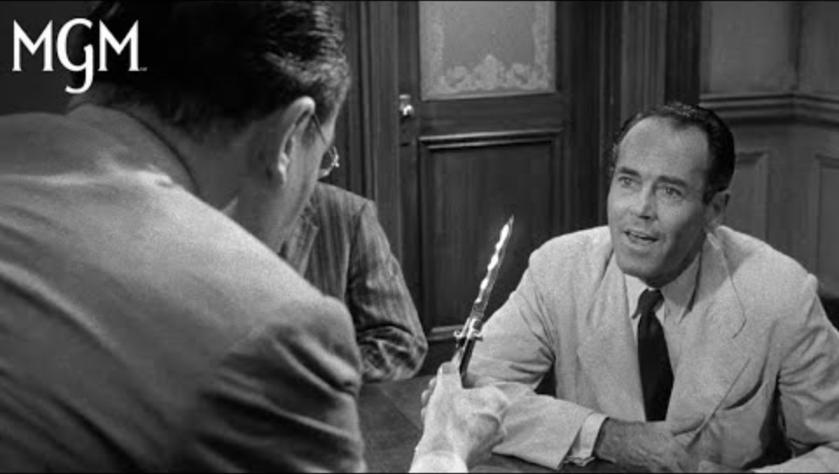
Evidence causes updating!

Slide 11
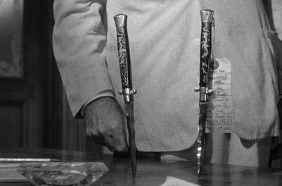
New evidence causes model updating
Evidence accumulates:
Similar knife is easy to find
Etc.
Jurors slowly become convinced
Time | Vote
0:06 | 11:1
0:28 | 10:2
0:46 | 9:3

Slide 12
2.2 Conditional probability
Joint, marginal, and conditional probability

Slide 13
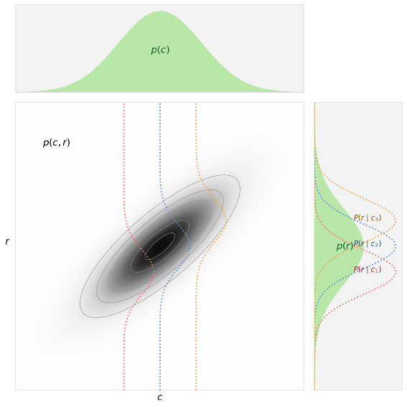
Joint probability is the probability of more than one variable
It can be used to find the conditional probability

Slide 14
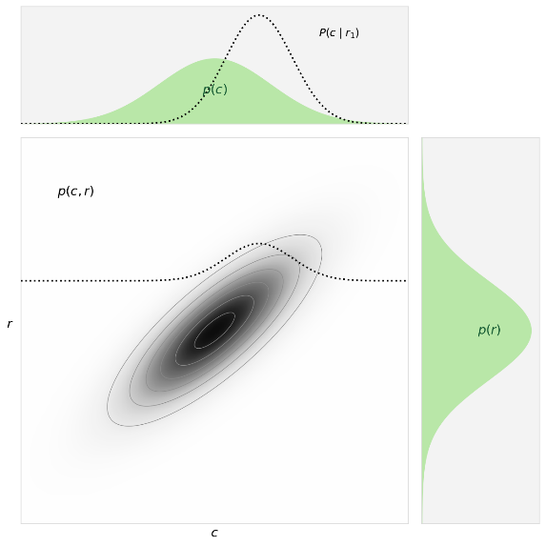
Conditional probability can go either direction
It can be used to find the conditional probability

Slide 15
A relationship between c|r and r|c

Slide 16
Conditional probability can be applied to data and models

Slide 17
2.3 Bayes rule
Prior, likelihood, posterior, and evidence

Slide 18

Bayes rule is based in conditional probability

Slide 19
We will use Baye’s rule to update our models

Slide 20
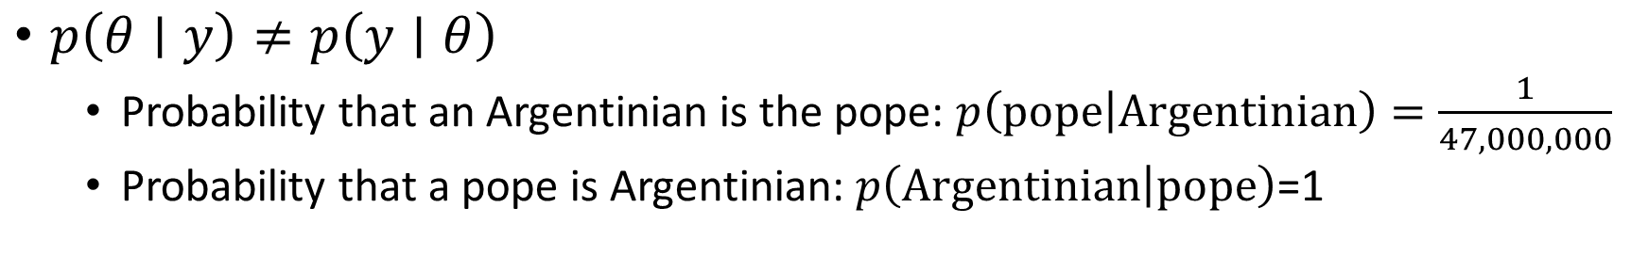
Baye’s rule can be counterintuitive
$p\left(θ∣y\right)≠p\left(y∣θ\right)$
Probability that an Argentinian is the pope: $p\left(\text{pope} | \text{Argentinian}\right)=\frac{1}{47,000,000}$
Probability that a pope is Argentinian: $p\left(\text{Argentinian} | \text{pope}\right)$=1

Slide 21
For us, each component has a name

Slide 22
2.4 Likelihood
Binomial model, coin flip, and likelihood functions

Slide 23
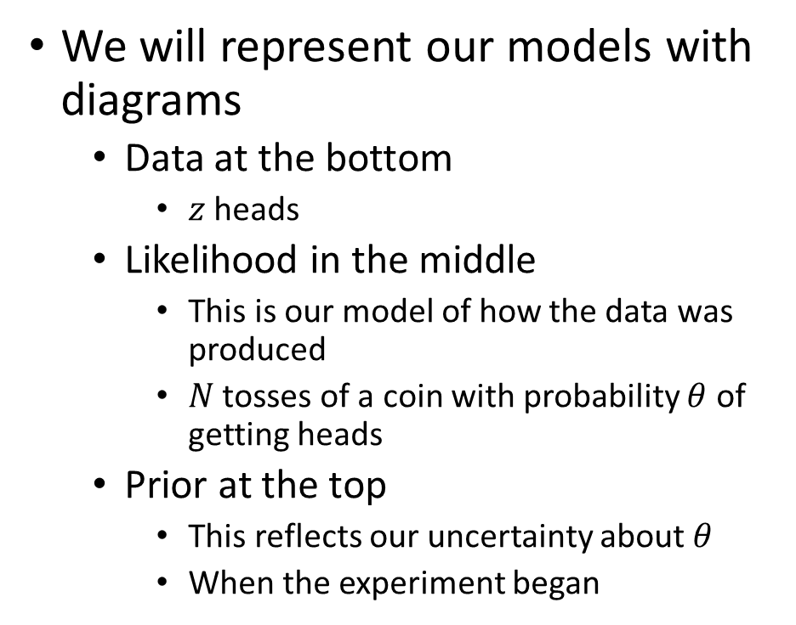
Graphical representation of models can be helpful
We will represent our models with diagrams
Data at the bottom
$z$ heads
Likelihood in the middle
This is our model of how the data was produced
$N$ tosses of a coin with probability $θ$ of getting heads
Prior at the top
This reflects our uncertainty about $θ$
When the experiment began
Prior
Likelihood
Data

Slide 24
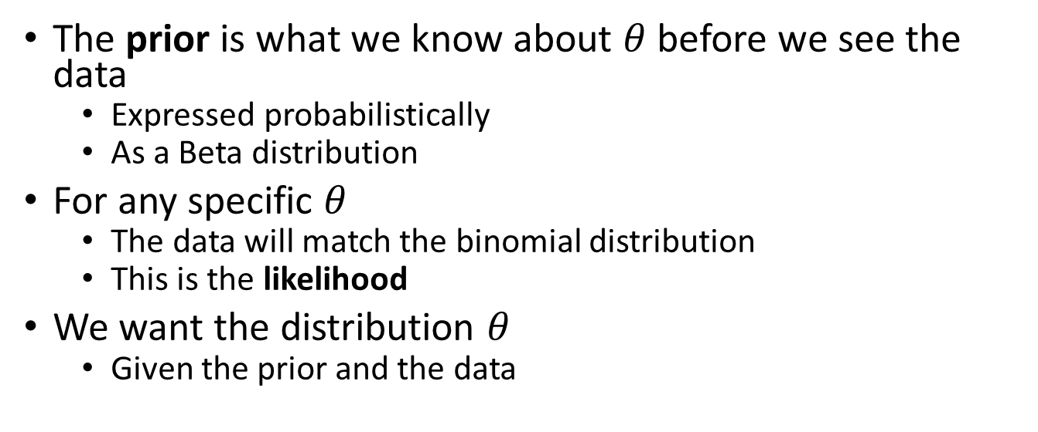
Models can be expressed mathematically
Prior
The prior is what we know about $θ$ before we see the data
Expressed probabilistically
As a Beta distribution
For any specific $θ$
The data will match the binomial distribution
This is the likelihood
We want the distribution $θ$
Given the prior and the data
Likelihood
Data

Slide 25

The probability of getting z heads in N coin tosses
As a function of the parameter!
This is a probability over $y$
For a coin with probability $θ$, the Bernoulli distribution

Slide 26
The likelihood function: Probability of data given the parameter
For a coin with probability $θ$, the Bernoulli distribution
For multiple flips, the Binomial distribution

Slide 27
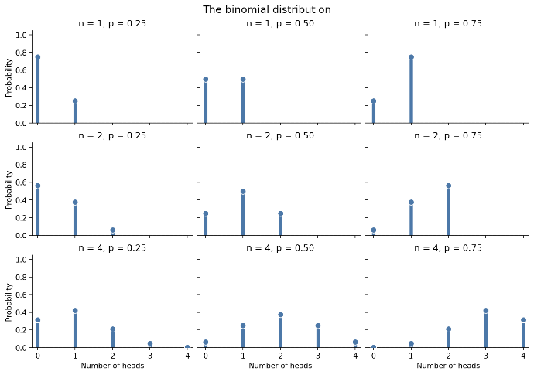
The binomial distribution

Slide 28
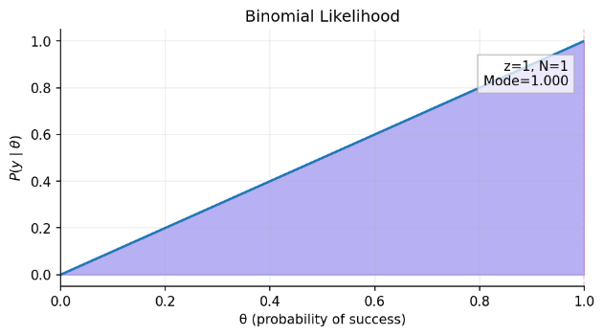
Likelihood for a simple coin flip

Slide 29
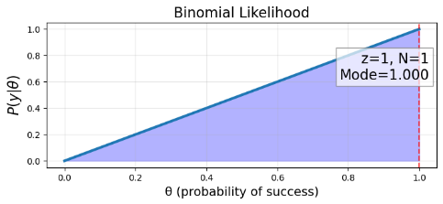
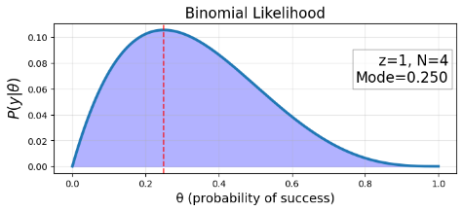
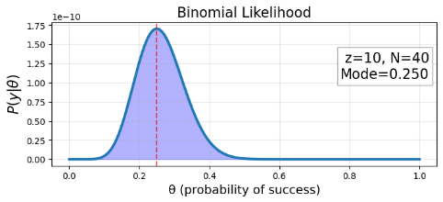
Likelihood for multiple coin flips

Slide 30
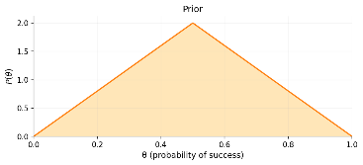
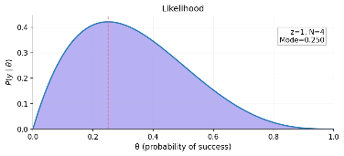
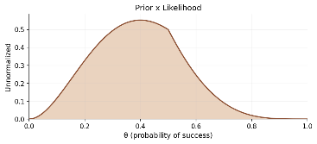
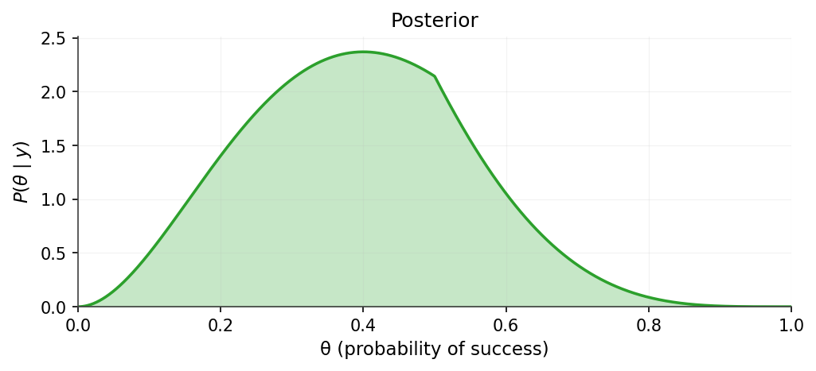
Bayes combines likelihood with prior
Essentially:
Multiply prior by likelihood
To get posterior

Slide 31
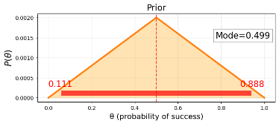

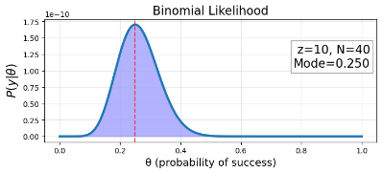
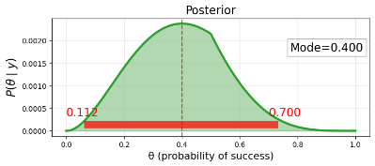
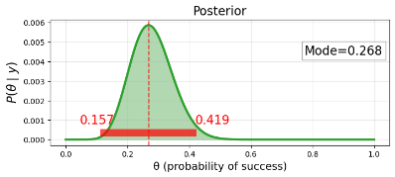
Changing likelihood affects posterior
As we add more data
Data will dominate prior
Except where prior is 0

Slide 32
2.5 Grid calculation
Computing the posterior on a full grid

Slide 33
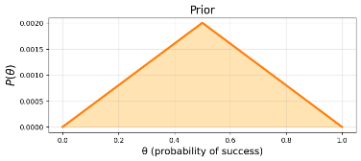
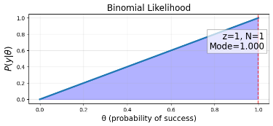
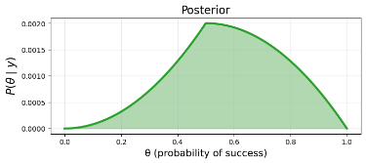
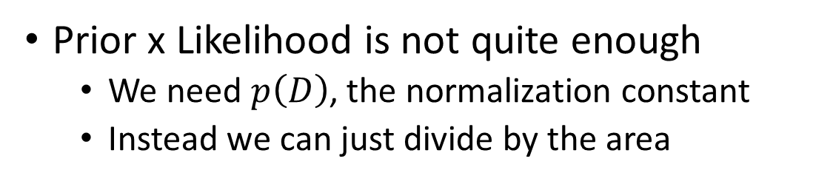
Grid calculation works point by point
Prior x Likelihood is not quite enough
We need $p\left(D\right)$, the normalization constant
Instead we can just divide by the area

Slide 34
The grid method
“Sample” at fixed intervals
Posterior is just prior times likelihood
And these are both easy to calculate
THETA_GRID = np.linspace(1e-4, 1 - 1e-4, 1200)
slide_prior = triangular_prior_density(THETA_GRID)
def posterior_from_product(theta, alpha, beta, z, n):
product = beta_density(theta, alpha, beta) * binomial_likelihood(theta, z, n)
return normalize_density(theta, product)
simple_posterior = posterior_from_curve(THETA_GRID, slide_prior, 1, 1)

Slide 35
Calculate first, then normalize
Normalizing is easy after you have the samples
THETA_GRID = np.linspace(1e-4, 1 - 1e-4, 1200)
slide_prior = triangular_prior_density(THETA_GRID)
def normalize_density(theta, density):
area = np.trapezoid(density, theta)
return density / area
def posterior_from_product(theta, alpha, beta, z, n):
product = beta_density(theta, alpha, beta) * binomial_likelihood(theta, z, n)
return normalize_density(theta, product)
simple_posterior = posterior_from_curve(THETA_GRID, slide_prior, 1, 1)

Slide 36
2.6 Prior
Prior beliefs, parameter uncertainty, and model assumptions

Slide 37
The prior is a probability distribution
Must integrate to 1

Slide 38
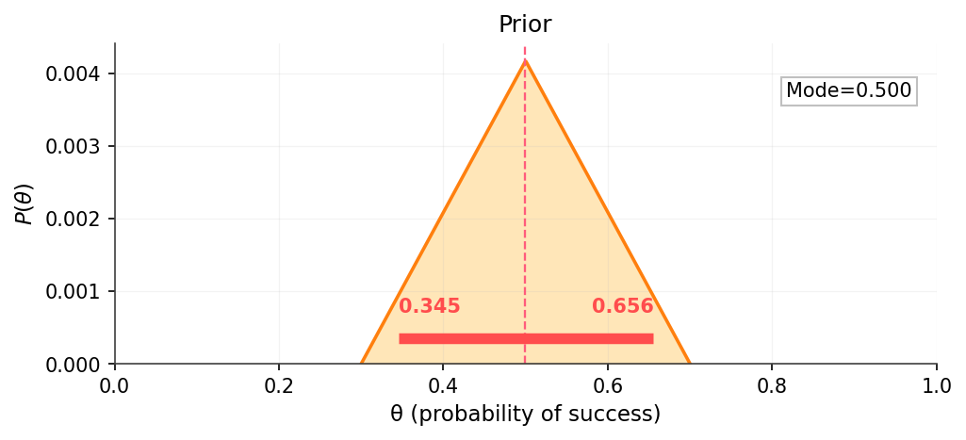
Priors are ideas about what is possible
We may be willing to accept any possibility
Or be very opinionated

Slide 39
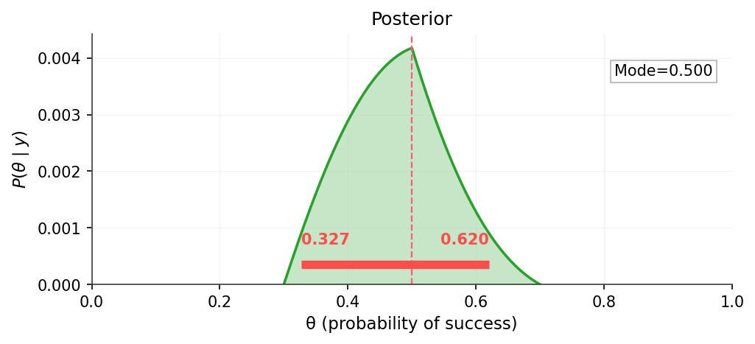
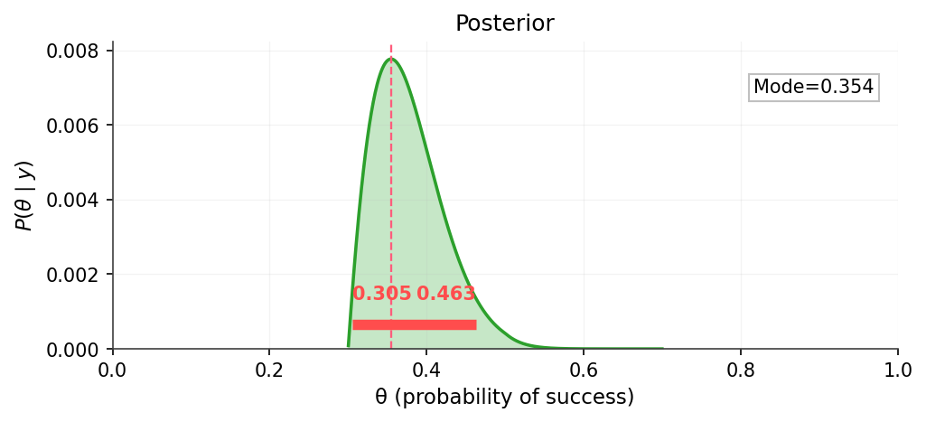
Posterior is affected by both priors and likelihood

Slide 40
2.7 Beta distribution
Probability distributions, Beta priors, and shape parameters

Slide 41
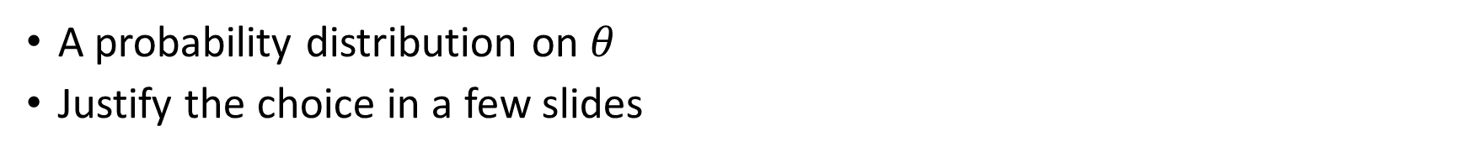
Use the Beta distribution for a prior
A probability distribution on $θ$
Justify the choice in a few slides
The beta distribution:
The beta function:
The gamma function generalizes the factorial:

Slide 42
Use the Beta distribution for a prior
A probability distribution on $θ$
Justify the choice in a few slides
The beta distribution:
The beta function:
The beta function normalizes the beta distribution:

Slide 43
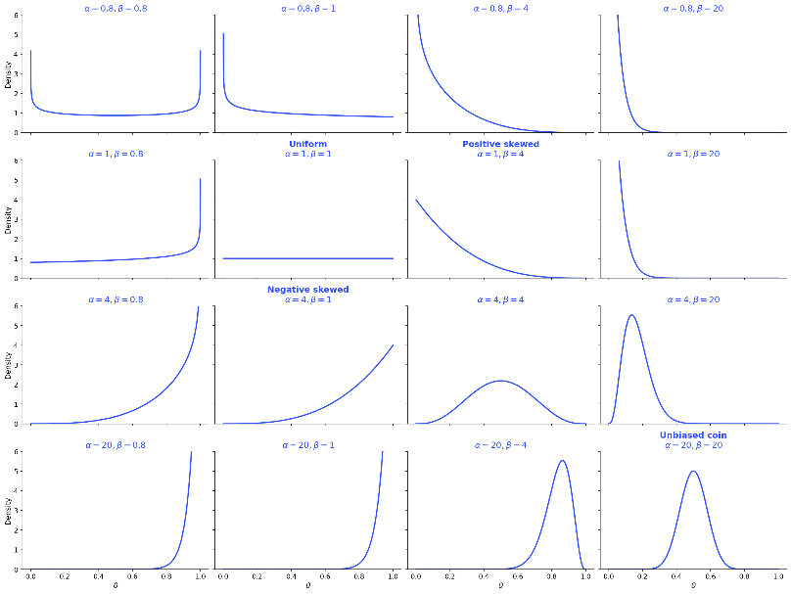
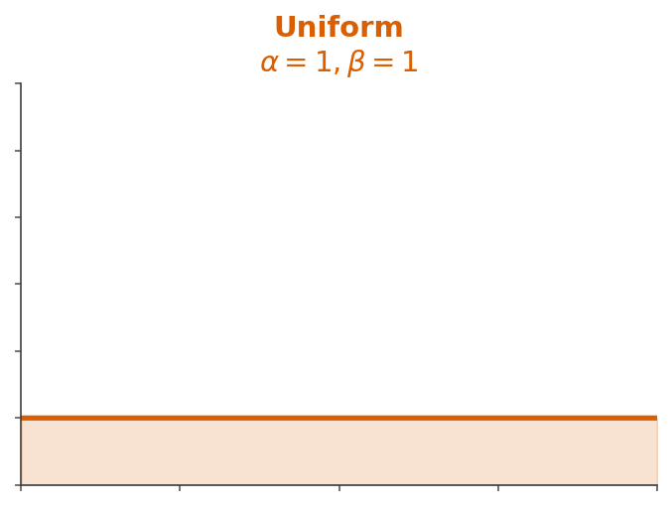
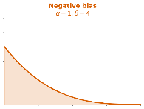
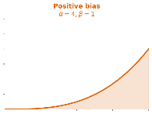
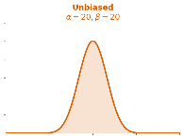
What does the Beta distribution look like?
A large variety of “plausible” probabilities
Uniform
Biased
Narrow

Slide 44
Why use the beta distribution as a prior for the binomial likelihood
Range of 0 to 1 makes sense for probility
Flexibility to represent many possible priors
The beta distribution is a conjugate prior for the binomial likelihood
A conjugate prior for a likelihood:
A family of priors where the posterior will also be in the family.

Slide 45
2.8 Conjugate priors
Beta-binomial conjugacy and updating

Slide 46
Beta prior + Binomial posterior → Beta posterior
This is a result of algebra
Briefly now in the slides
More fully in a handout
Prior:
Likelihood:
Posterior:

Slide 47
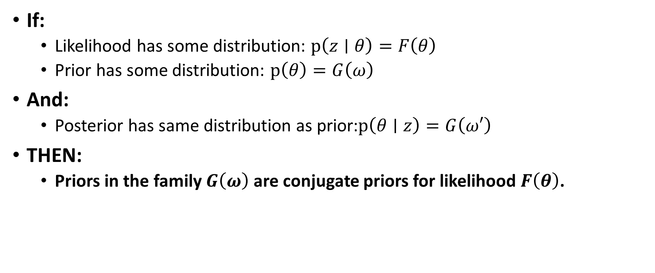
Beta is a conjugate prior for binomial likelihood
If:
Likelihood has some distribution: $p\left(z∣θ\right)=F\left(θ\right)$
Prior has some distribution: $p\left(θ\right)=G\left(ω\right)$
And:
Posterior has same distribution as prior:$p\left(θ∣z\right)=G\left(ω′\right)$
THEN:
Priors in the family $G\left(ω\right)$ are conjugate priors for likelihood $F\left(θ\right)$.

Slide 48
A simplified derivaiton
Prior:
Likelihood:
Posterior:

Slide 49

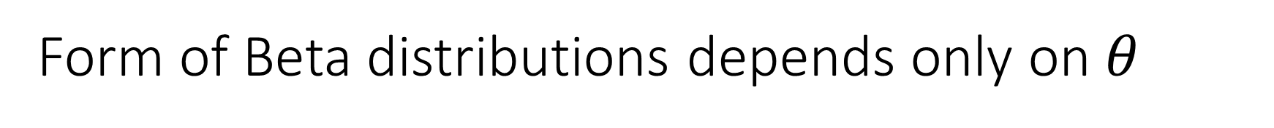
Form of Beta distributions depends only on $θ$
Posterior:
Beta distribution

Slide 50
Bayesian simplification through proportionality
Prior:
Likelihood:
Posterior:
Beta distribution

Slide 51
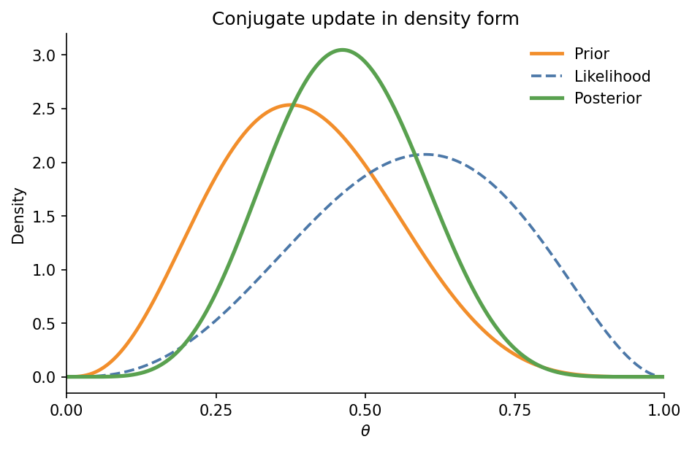
Analytic solution to Bayesian estimation
If the prior is a Beta distribution
Then the posterior is a different Beta distribution

Slide 52
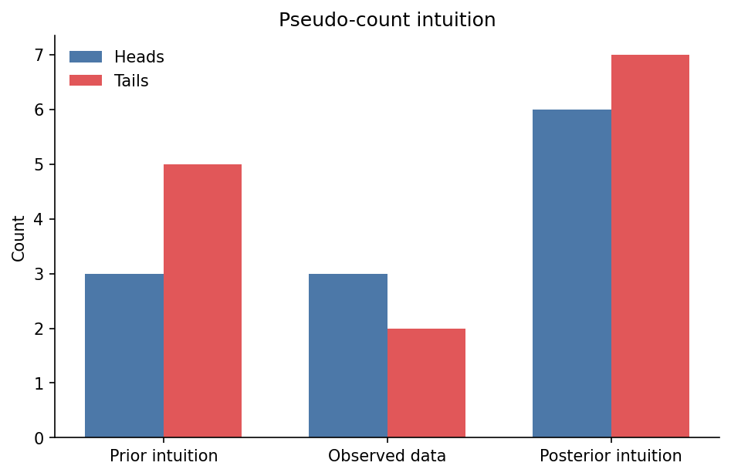
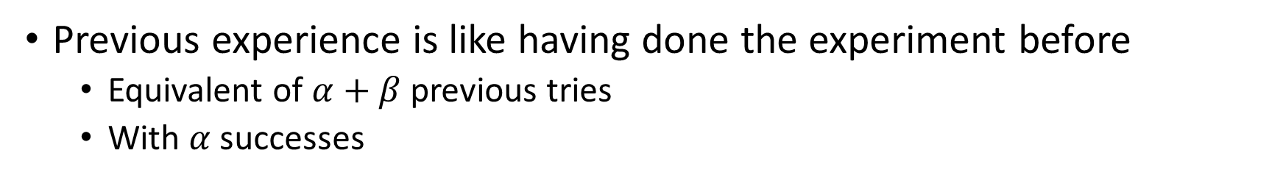
Pseudo-count interpretation of conjugate prior
Previous experience is like having done the experiment before
Equivalent of $α+β$ previous tries
With $α$ successes

Slide 53
2.9 Posterior distribution
Posterior updating and accumulation of evidence

Slide 54
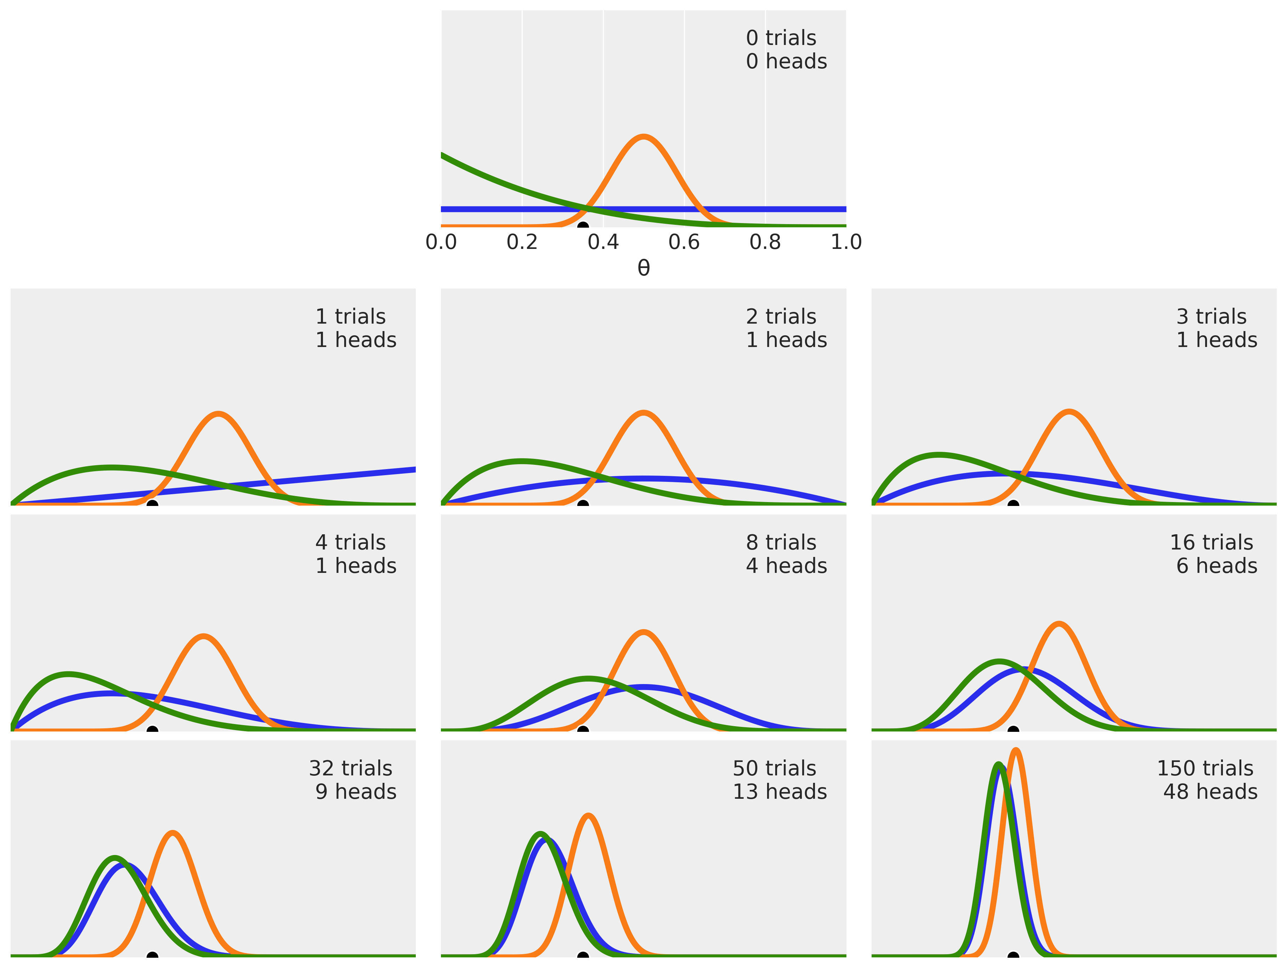
Apply this to coin flipping
Imagine three different priors
Uniform prior: a=1, b=1
Prior for unbiased: a=20, b=20
Positive skewed prior: a=1, b=4
Can you tell which is which?

Slide 55
Flip your first coin
Imagine three different priors
Flip a coin, get a head
Update the posterior

Slide 56
Flip your second coin
Imagine three different priors
Flip two coins, get one head
Update the posterior

Slide 57
Flip your third coin
Imagine three different priors
Flip three coins, get one head
Update the posterior

Slide 58
Keep flipping coins

Slide 59
Still using grid method to find posterior
for ax, n, z in zip(axes_flat[1:10], n_trials[1:], n_heads[1:]):
ax.set_visible(True)
for _, alpha, beta, color in PRIOR_SPECS:
posterior = posterior_density(THETA_GRID, alpha, beta, z, n)
ax.plot(THETA_GRID, posterior, color=color, linewidth=2.0)
ax.axvline(theta_real, color="0.35", linestyle=":", linewidth=1.2)
ax.set_title(f"N = {n}, z = {z}")
format_theta_axis(ax, ylabel=None, xlabel=False)

Slide 60
Many things to learn from this figure
A Bayesian analysis leads to a distribution
Mode of distribution gives most probable value
Spread of distribution gives uncertainty
More data leads to:
Less spread, less uncertainty
Converging posteriors, agreement on most probable value
Some priors are equivalent even with small amounts of data

Slide 61
One more thing to know
We could add the data in different orders
The final result would be the same

Slide 62
2.10 Choosing priors
Weak priors, strong priors, and prior elicitation

Slide 63
The history of choosing priors
1930s-1950s: Objective priors
Choose according to a mathematical principle
1960s: Maximum entropy priors
Minimize extra information given constraints
1980s-1990s: Vague priors
Make priors broad enough that they do not matter
An effort to appease frequentist critique
2000s: Empirical priors
Base priors on data
2010s: Weakly informative priors
Stabilize analyses
2020s: Automatic prior selection
Choose according to a mathematical principle

Slide 64
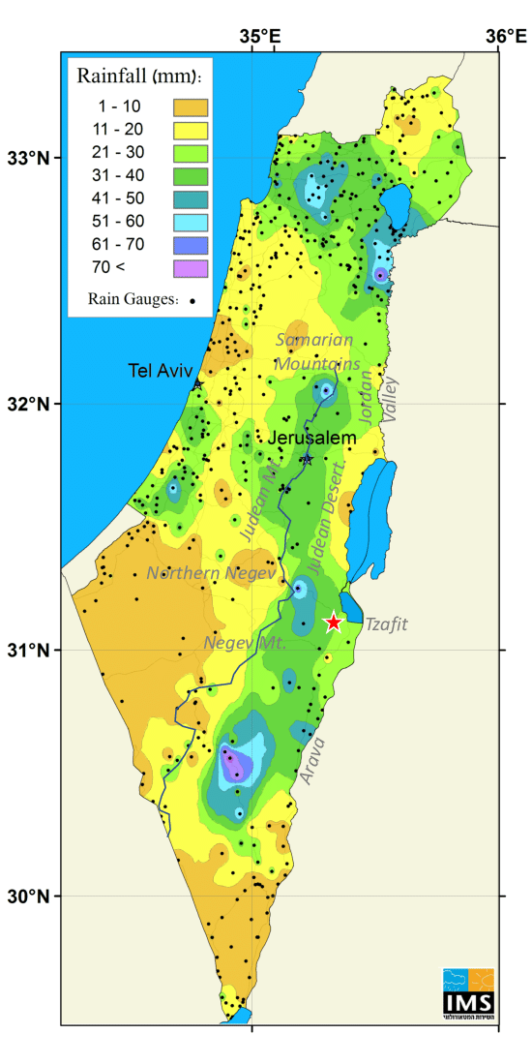
Choosing strong priors
In many hard problems, strong priors make sense
Election polling
Weather prediction
Genetics
Strong priors are necessary when there is weak data
Strong priors are inappropriate when there is strong data
Unless you don’t trust the data
Like in election polling

Slide 65

Prior elicitation
Approaches for translating expert knowledge into prior distributions
What questions does it make sense to ask an expert?
How can you take their answers and create a prior distribution?
How can you iterate this process to converge to a prior distribution that truly reflects the expert knowledge

Slide 66
2.11 Preliz
Exploring distributions and finding priors

Slide 67
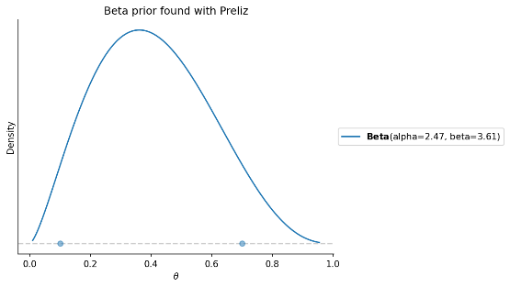
Preliz: a package for prior elicitation
I’m pretty sure the coin’s probability is somewhere between 0.1 and 0.7
maxent finds a Beta prior with X% of the probability between low and high
And displays it
import preliz as pz
dist = pz.Beta()
pz.maxent(dist, 0.1, 0.7, 0.9)

Slide 68
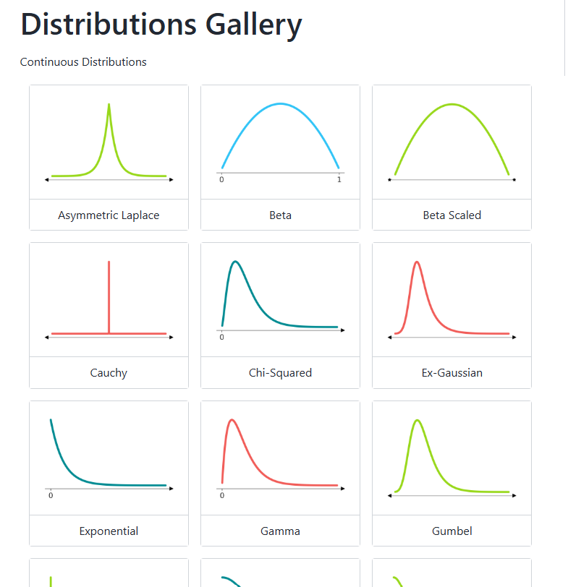
Preliz is handy for learning distributions
See the full gallery here:
https://preliz.readthedocs.io/en/latest/gallery_content.html
We will use many of these distributions.
This is a great reference
And it can also help in prior selection

Slide 69
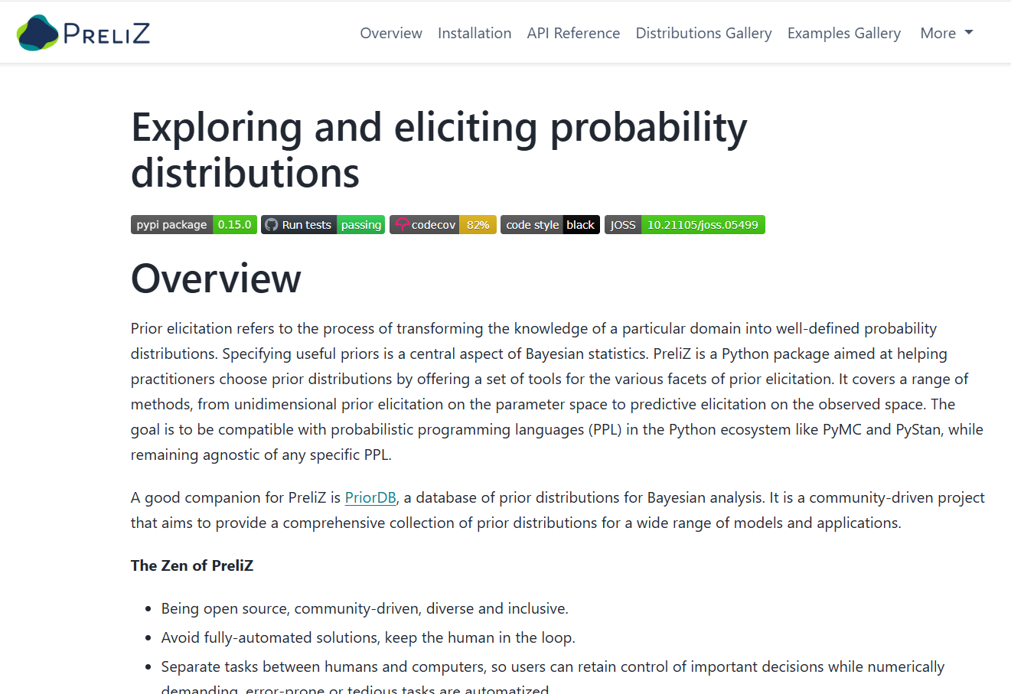
Preliz home page
https://preliz.readthedocs.io/en/latest/index.html

Slide 70
2.12 Next week
Beyond grid calculations

Slide 71

Sampling as an alternative to grid computation
Grid computation breaks down in high dimensions
The better option:
More information where there is more probability
Sampling!

Slide 72
PyMC does sampling or us
Preliz
Specialized applications
PyMC
Distributions
Samplers
Models
Arviz
Utilities
Variational Bayes
Bambi

